Slide 1
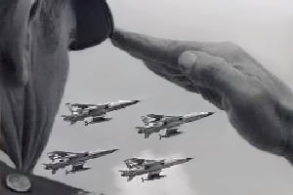
NEVER FORGET

Slide 2
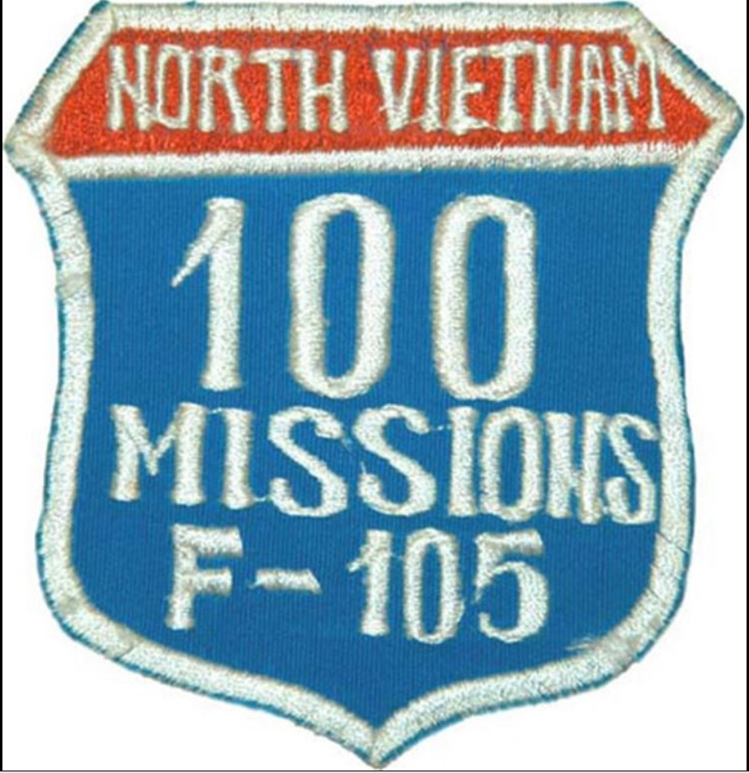
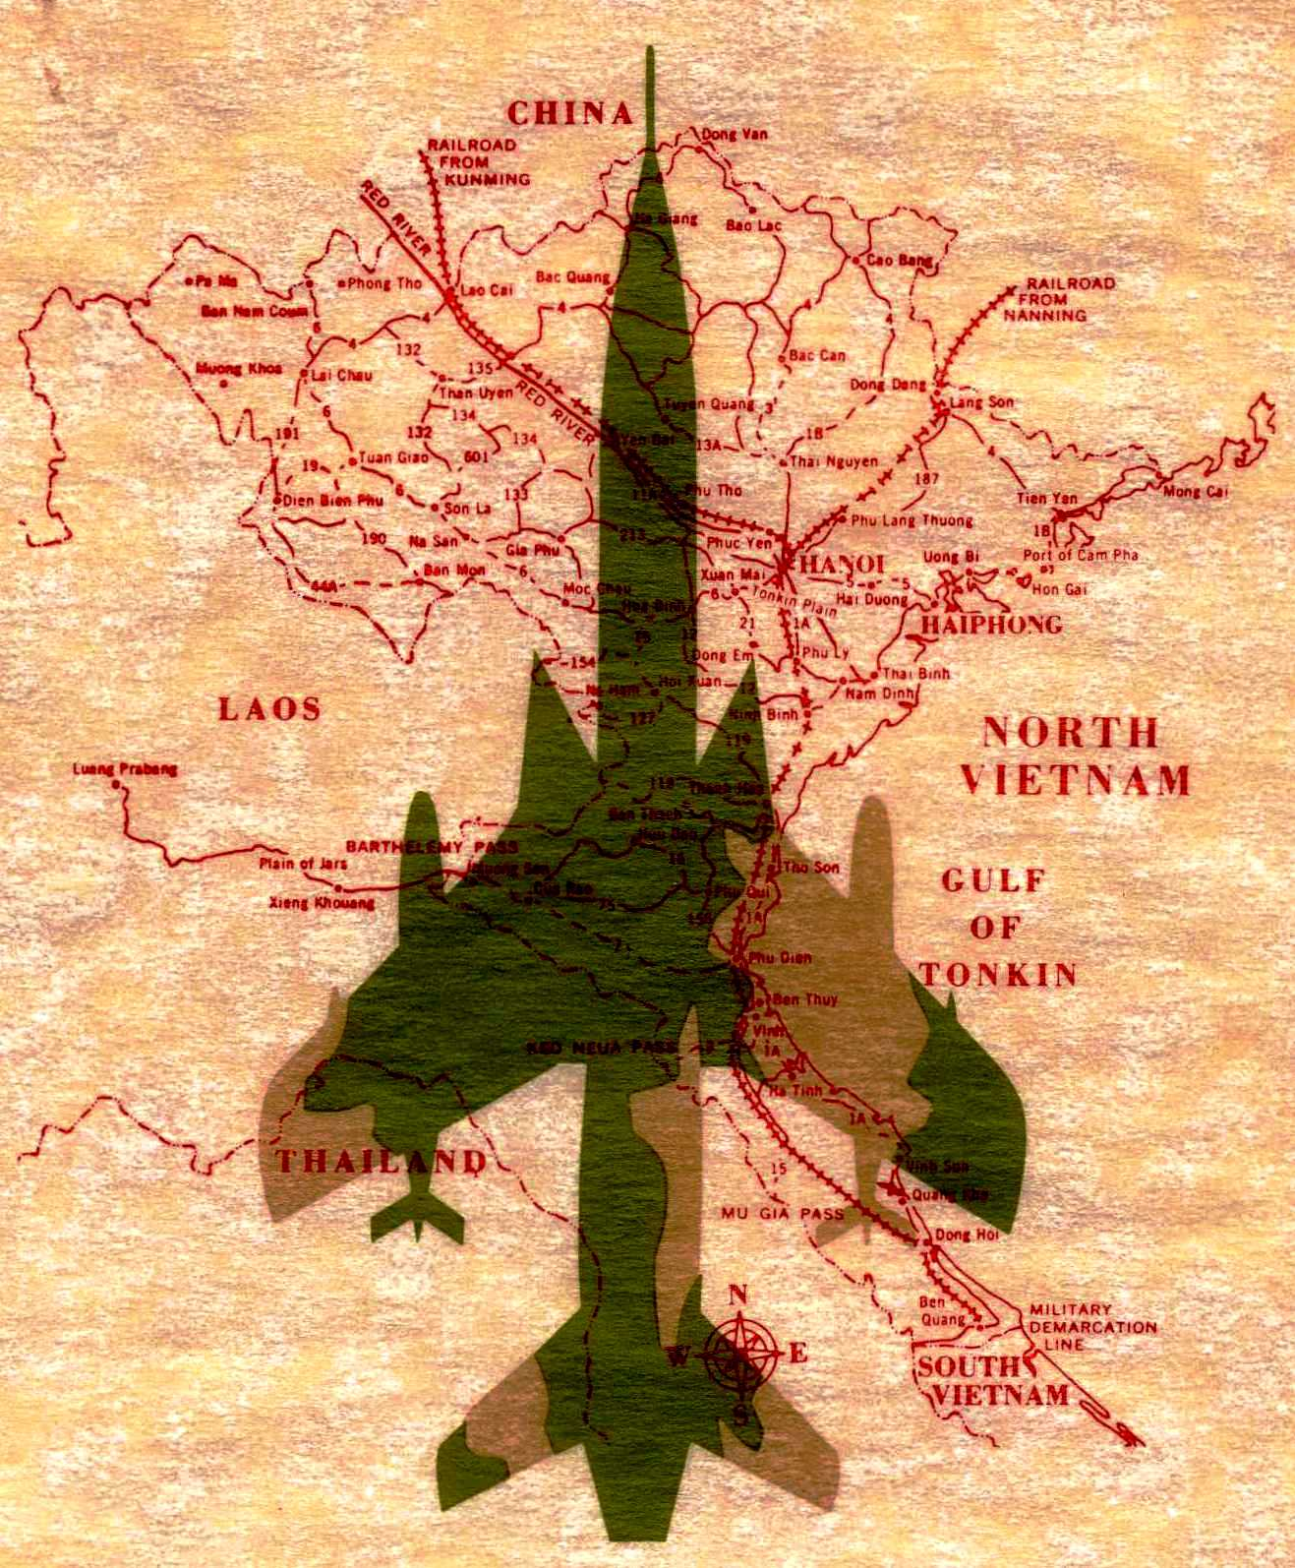
REMEMBERING OUR FRIENDS ….
Slides have rank, name, date of loss, type of loss & sqdn patch flying with at the time of loss … slides cycle after 6 seconds
Slides do not include pilots/Bears shot down & rescued or who came home after being a POW
Data compiled from multiple sources:
  https://www.dpaa.mil/
  https://www.vvmf.org/Wall-of-Faces
  https://www.vietnamairlosses.com
A special thanks to Dave “Micro” Lovelady and Chris Hobson of Vietnam Air Losses and Chris Williamson of the DoD POW/MIA Accounting Agency for their invaluable help in verifying the data in this presentation

Slide 3

Rank & Name of Pilot or “Bear” (term for Electronic Warfare Officer) *
* = Still unaccounted for
Date shot down & How shot down
AAA = anti-aircraft artillery
SAM = Surface to Air missile
MiG = NVN fighter jet
SQUADRON PATCH
FLYING WITH
AT SHOOTDOWN
Picture

Slide 4
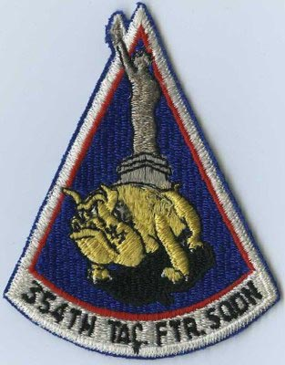
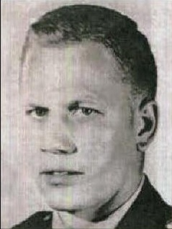
Capt James Magnusson *
4 April 1965 MiG 17 near Thanh Hoa

Slide 5
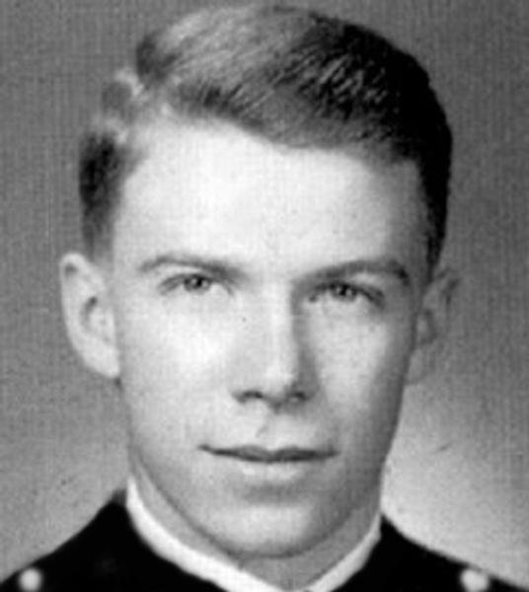
Maj Frank Bennett
4 Apr 1965 MiG 17 near Thanh Hoa

Slide 6
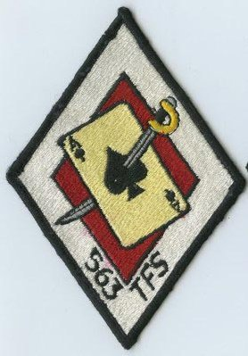
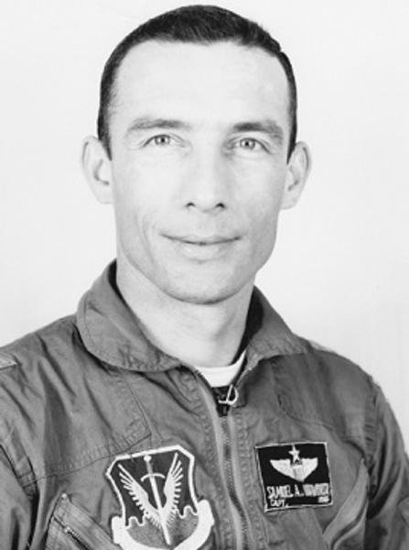
Capt Samuel Woodworth *
17 April 1965 AAA Mu Gia Pass

Slide 7
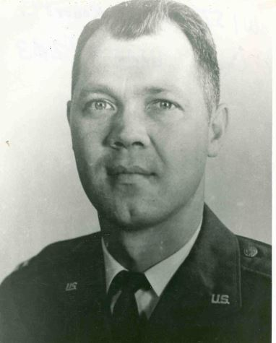
Captain Robert Wistrand *
9 May 1965 AAA Mu Gia Pass

Slide 8
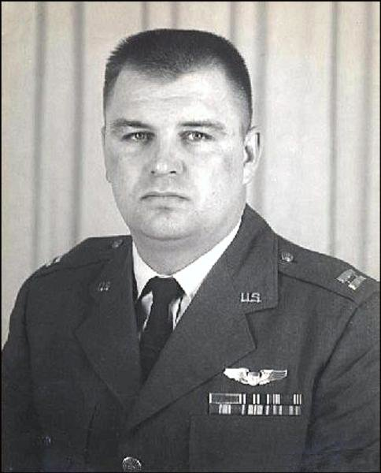
Captain Robert Greskowiak
15 May 1965 Crash on takeoff @ Takhli

Slide 9
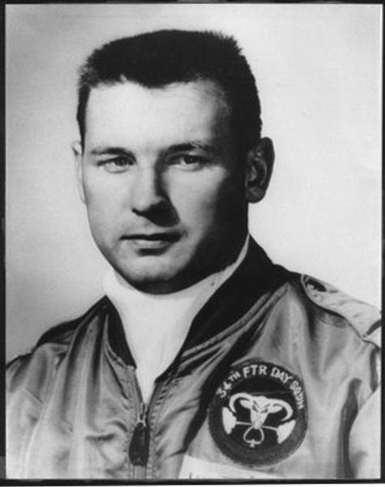
Capt David Hrdlicka *
18 May 1965 AAA in Laos
Died while POW

Slide 10
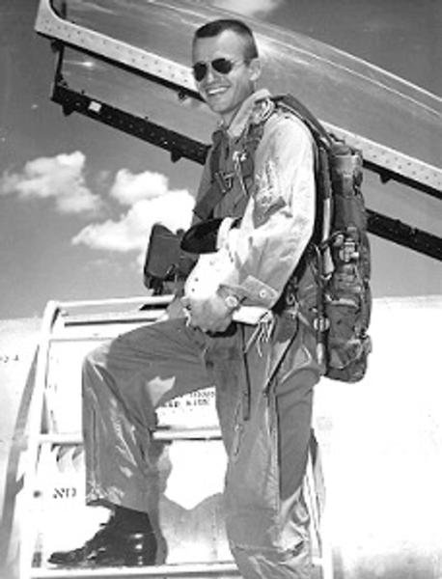

Capt Don Williamson
7 July 1965 AAA near Vinh
6 July 1965 AAA near Vinh

Slide 11
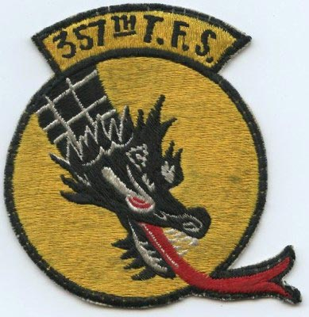
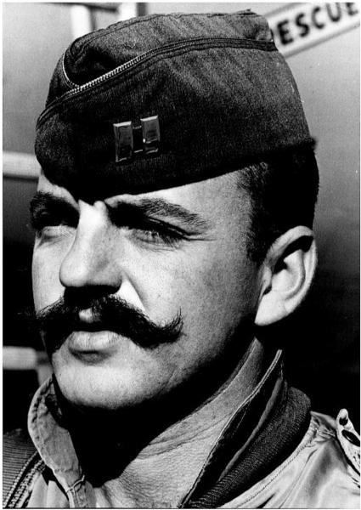
Capt William Barthelmas
27 July 1965 Post Strike Mid-Air w/Farr

Slide 12
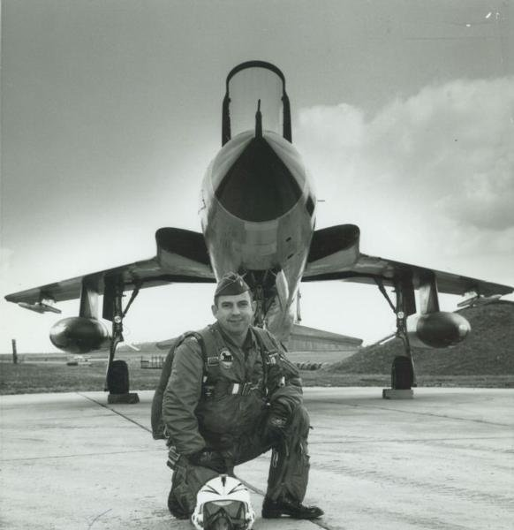
Major Jack Farr
27 July 1965 Post Strike Mid-Air w/Barthelmas

Slide 13
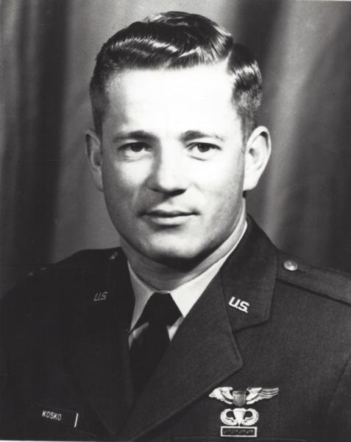
Capt Walter Kosko *
27 July 1965 AAA over NVN

Slide 14
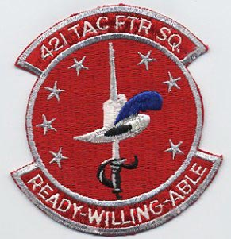
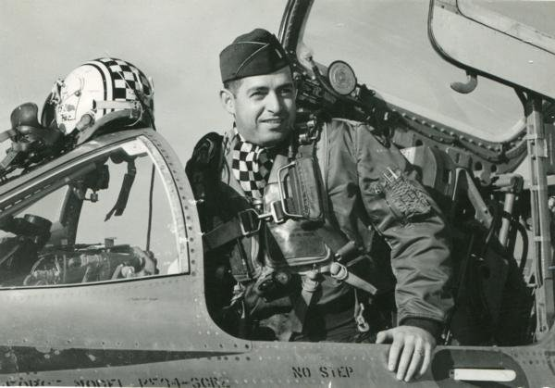
Maj Joseph Bower
3 August 1965 AAA over NVN

Slide 15
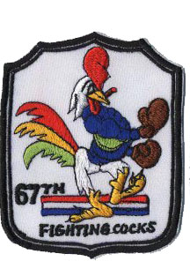
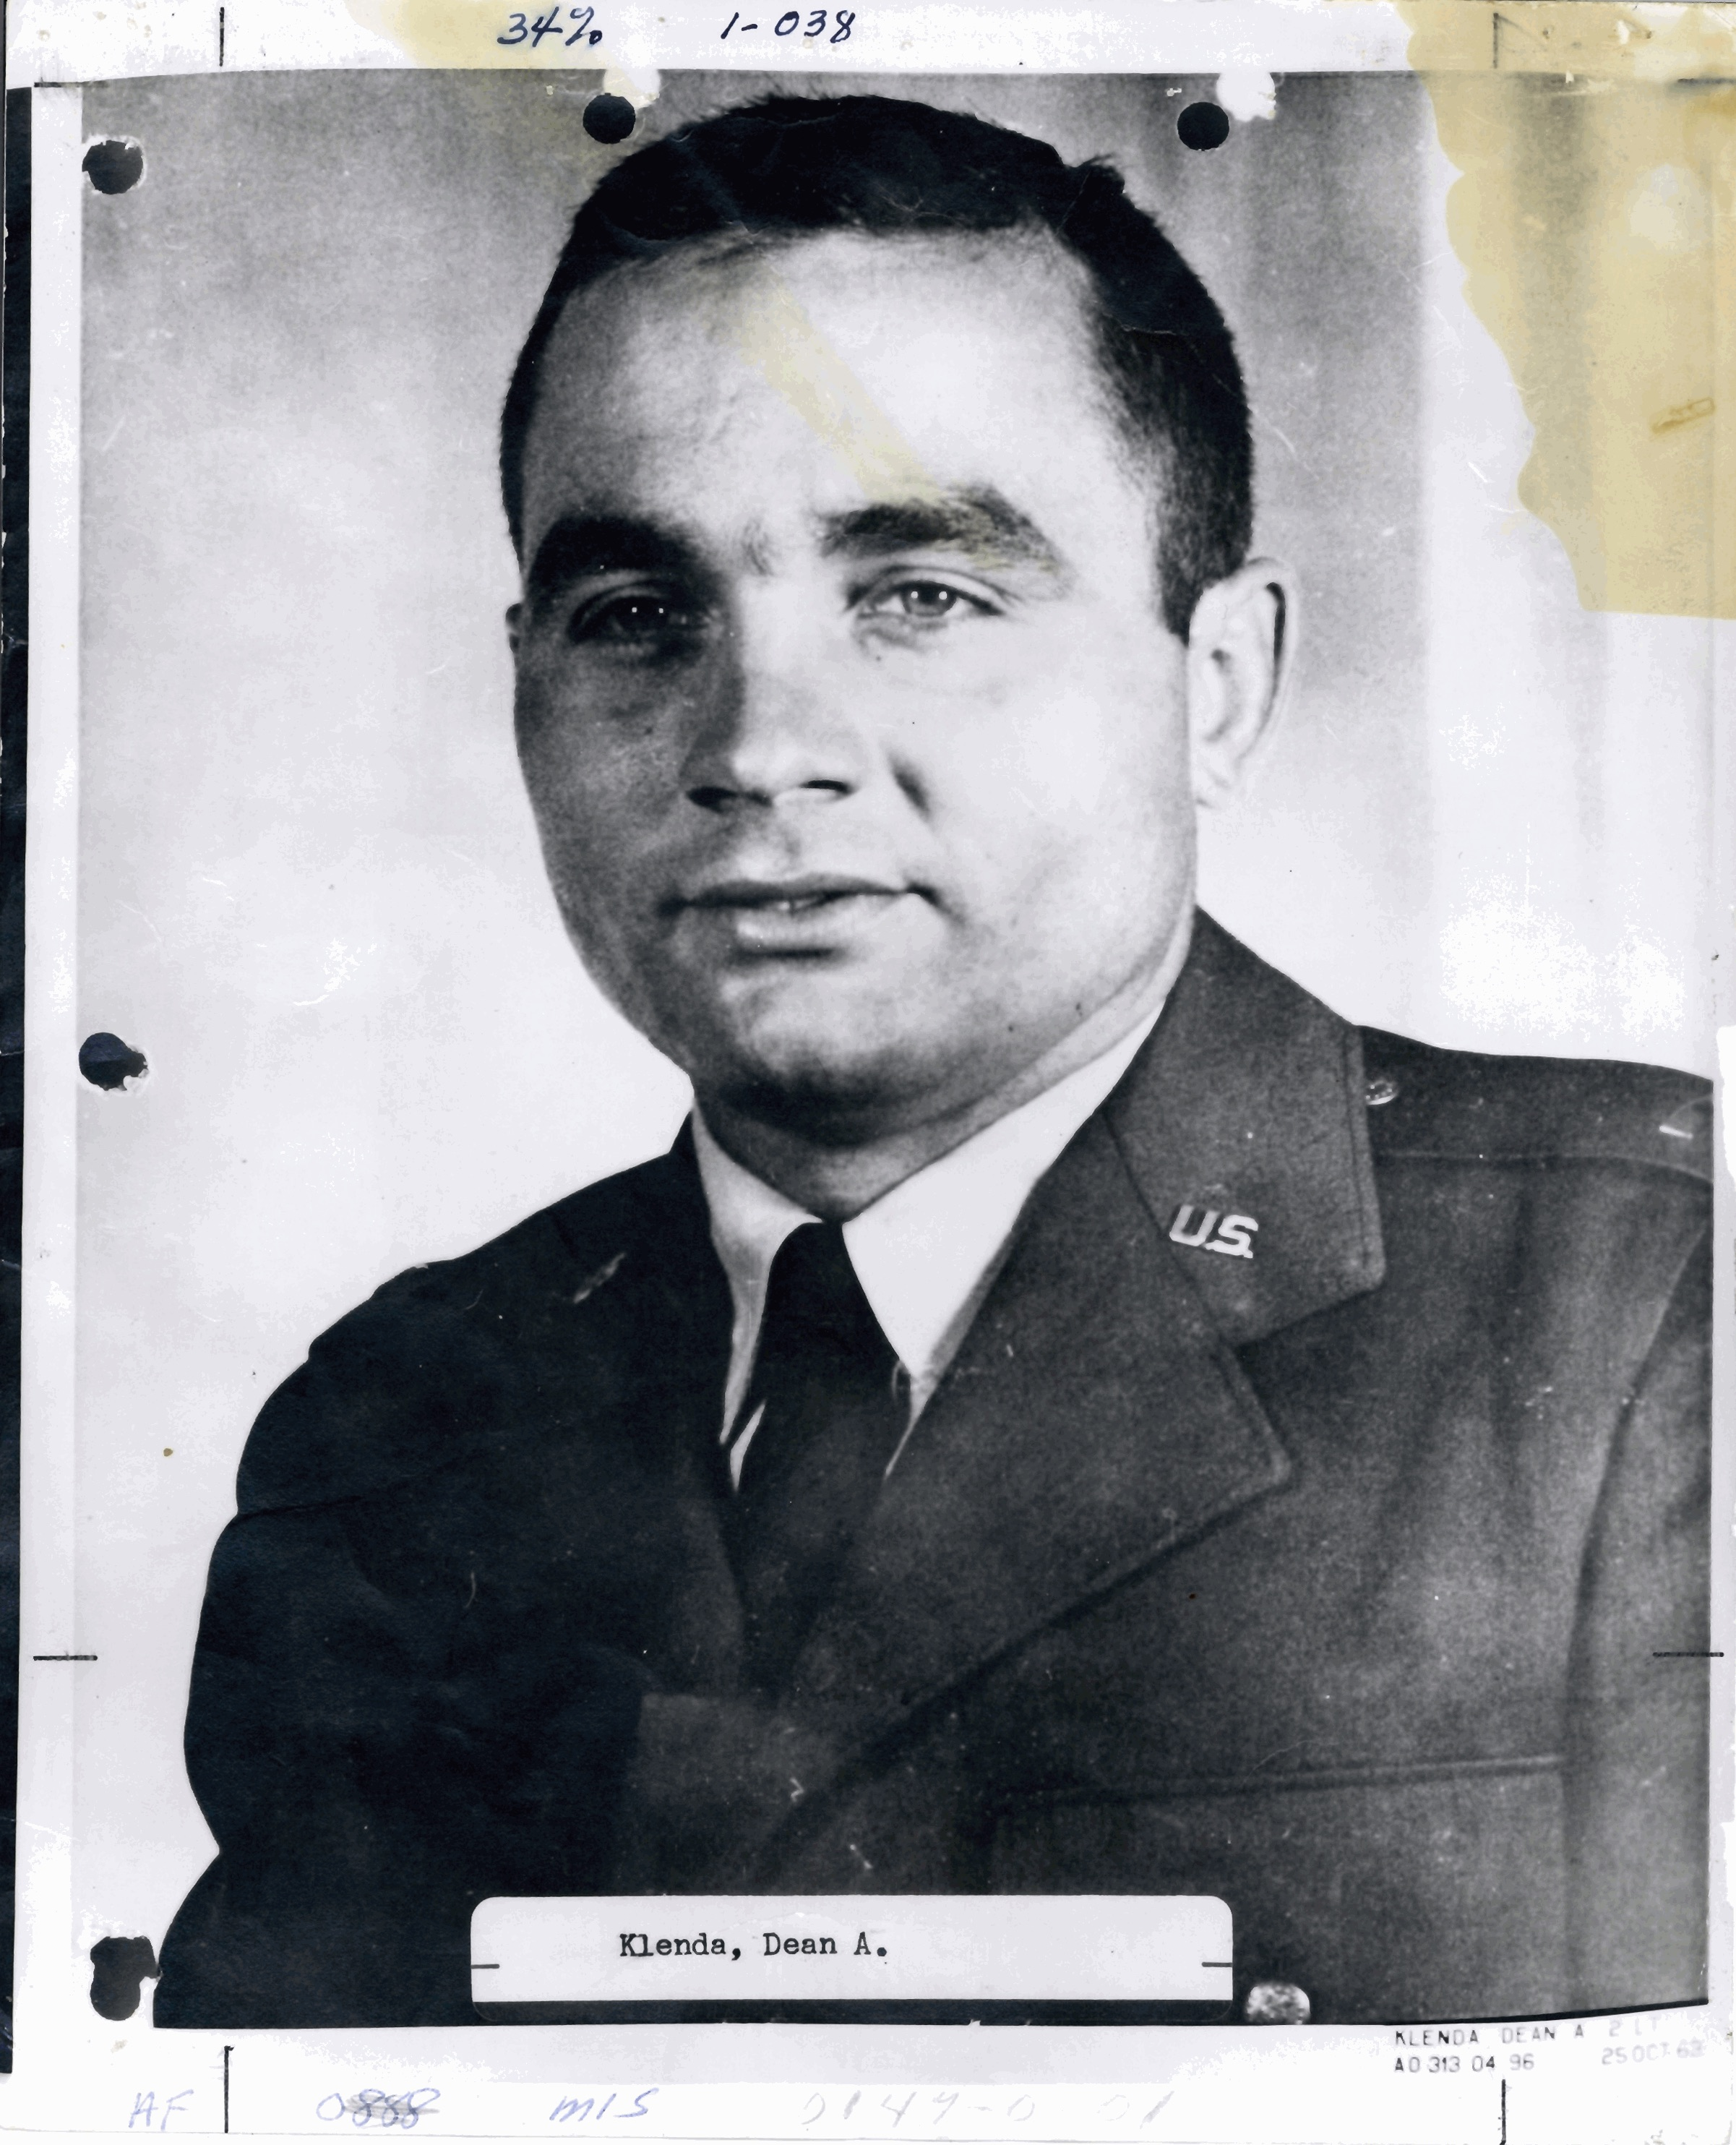
1 Lt Dean Klenda
17 September 1965 AAA over NVN

Slide 16
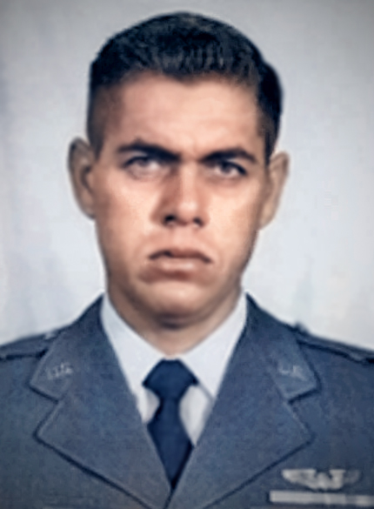
Capt Edgar Hawkins *
20 September 1965 AAA over NVN

Slide 17
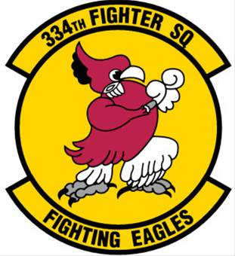
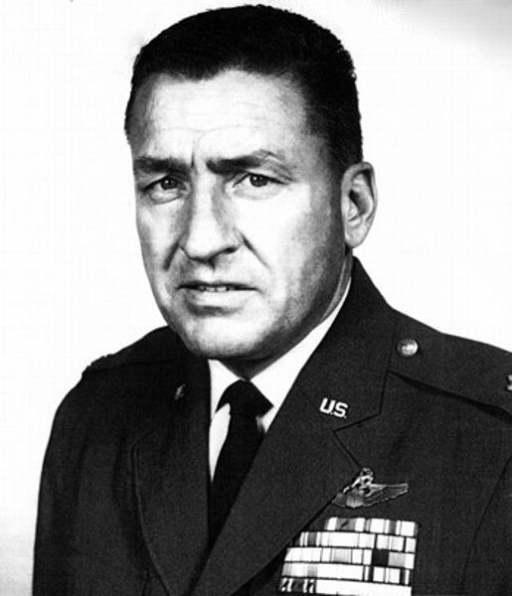
Lt Col Melvin Killian 334 TFS/CC
30 September 1965 SAM over NVN

Slide 18
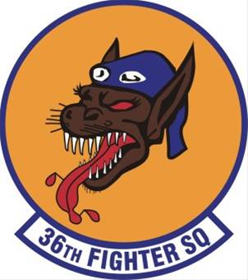
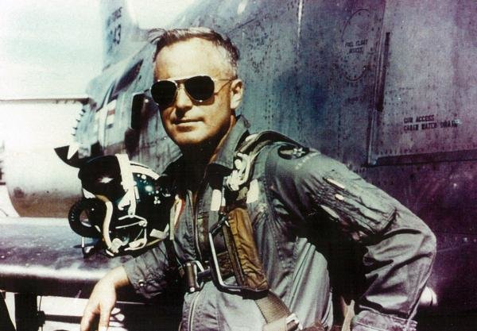
Maj Dean Pogreba AF Cross *
5 October 1965 AAA over NVN

Slide 19
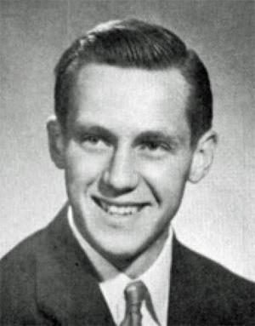
Capt Robert Schuler
14 October 1965 AAA over NVN

Slide 20
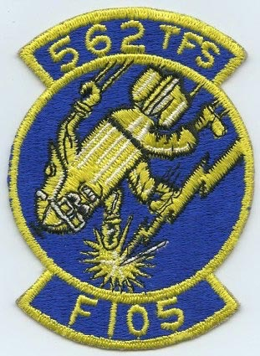
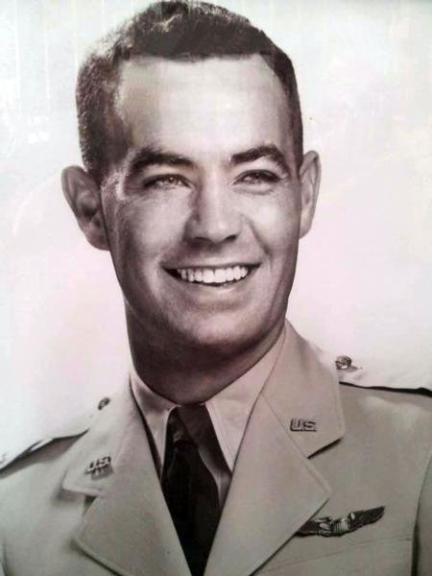
Capt Dwight Bowles *
3 November 1965 Bomb run crash NVN

Slide 21
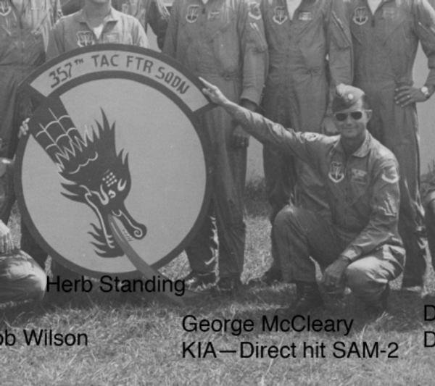
Lt Col George McCleary (357 TFS/CC)
5 November 1965 SAM over NVN

Slide 22
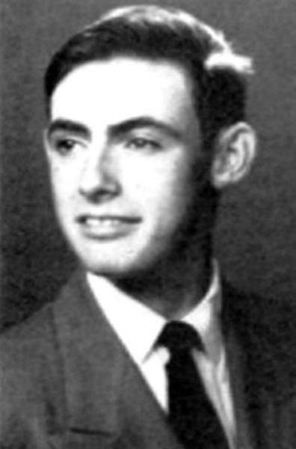
Capt William “Nasty Ned” Miller
12 November 1965 Bomb exploded on rack

Slide 23
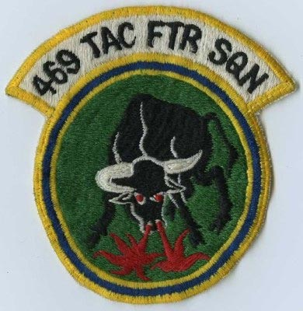
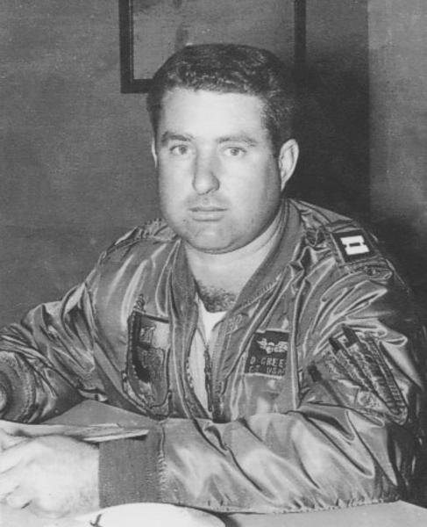
Capt Donald Green *
16 November 1965 SAM over NVN

Slide 24
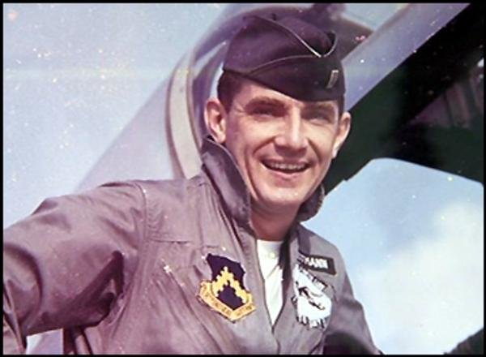
Capt Thomas Reitmann
1 December 1965 AAA near Hanoi

Slide 25
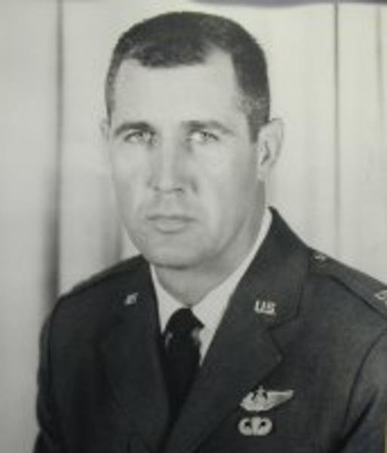
Captain Don Wood *
16 January 1966 AAA over Laos
Died while POW

Slide 26
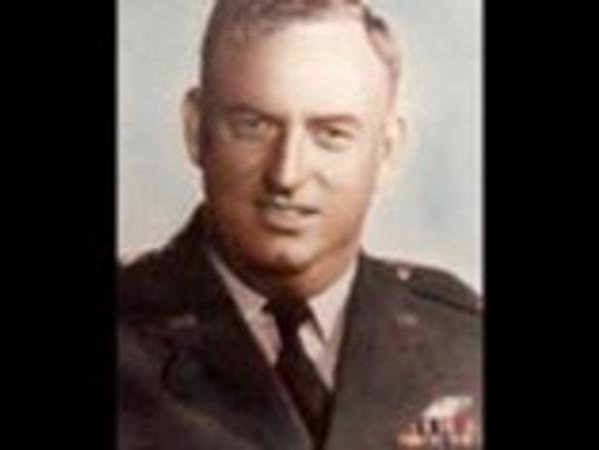
Capt Eugene Hamilton
31 January 1966 AAA over NVN

Slide 27
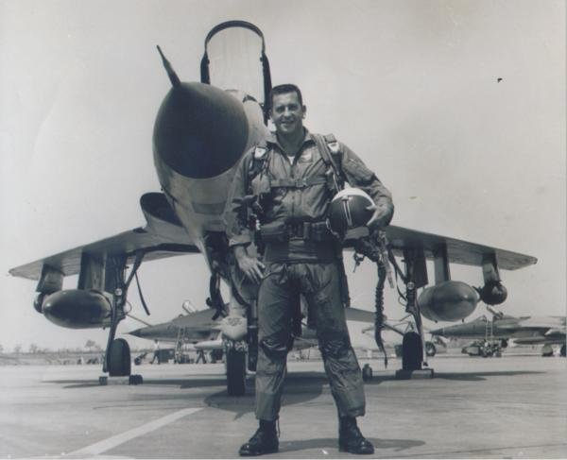
Capt Harold Smith
7 March 1966 AAA over NVN

Slide 28
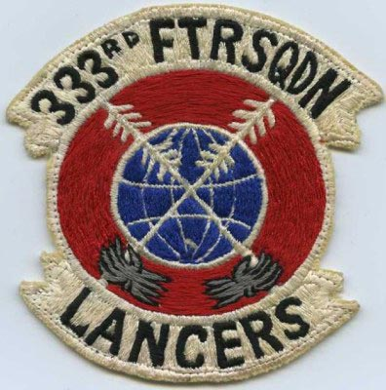
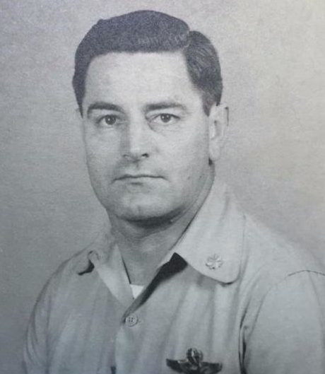
Maj Paul Underwood
16 March 1966 AAA near Dien Bien Phu

Slide 29
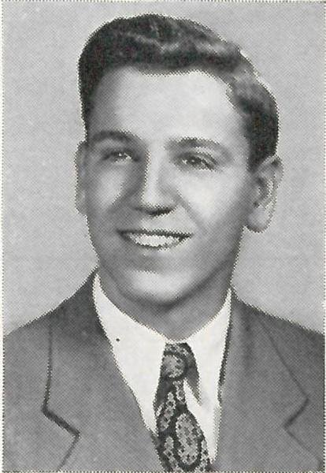
Capt Robert Bush
24 March 1966 AAA over NVN

Slide 30
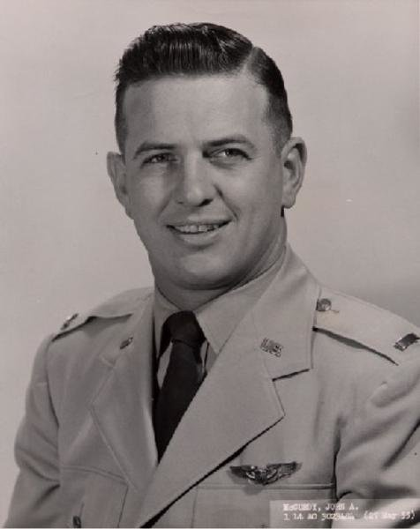
Capt John McCurdy
15 April 1966 Landing crash at Korat

Slide 31
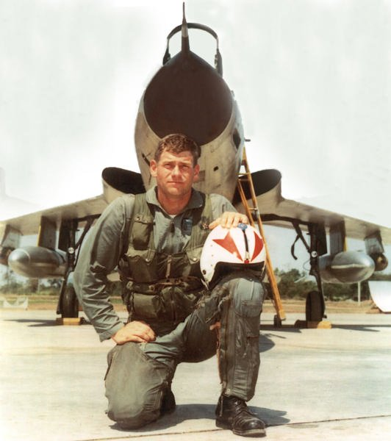
1 Lt Lee Adams
19 April 1966 AAA in NVN (90th mission)

Slide 32
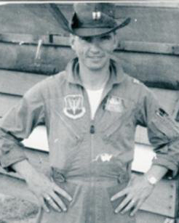
Capt Robert Dyczkowski
23 April 1966 AAA over NVN, 99th mission

Slide 33
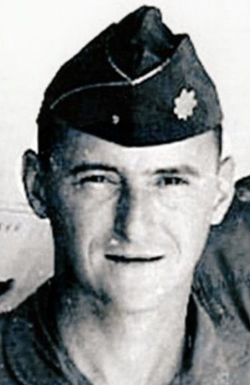
Maj Bernard Goss
23 April 1966 AAA over NVN
Killed by captors

Slide 34
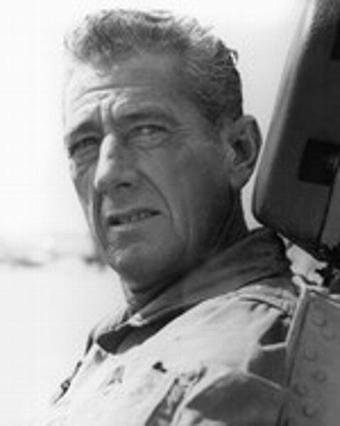
Lt Col William Cooper (469 TFS/CC & AF Cross)
24 April 1966 SAM near Thai Nguyen

Slide 35
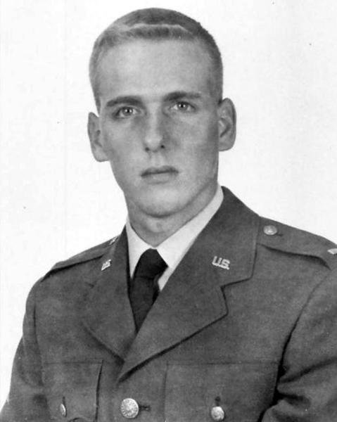
1 Lt Donald Bruch
29 April 1966 AAA north of Hanoi

Slide 36
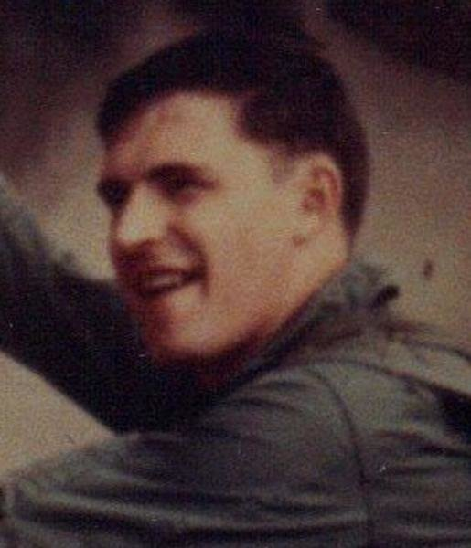
1 Lt Kenneth Thomas
5 May 1966 AAA over NVN

Slide 37
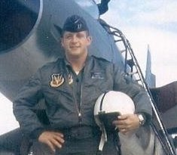
Capt John Bailey
10 May 1966 AAA near Dong Hoi

Slide 38
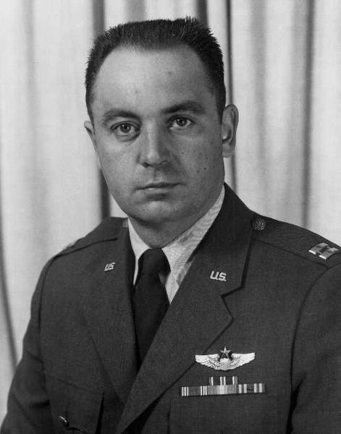
Capt Francis Feneley *
11 May 1966 AAA over NVN (on last mission)

Slide 39
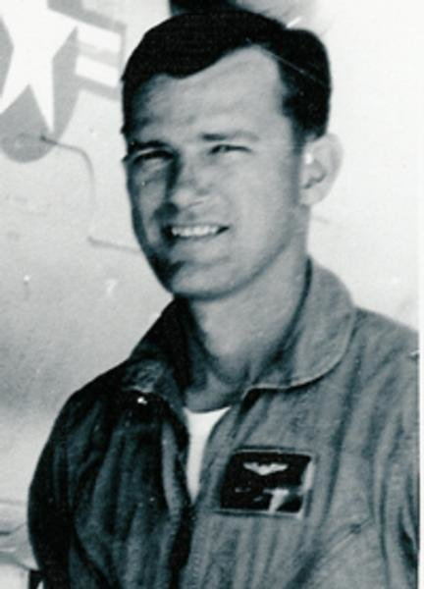
Capt Ralph Balcom *
15 May 1966 Unknown cause NVN

Slide 40
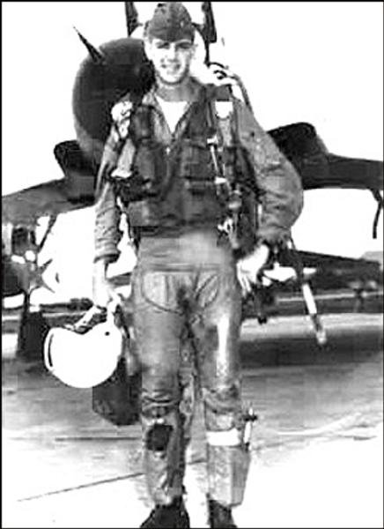
1 Lt Robert Hunter
25 May 1966 AAA over Laos

Slide 41

1 Lt Martin Steen *
31 May 1966 AAA near Yen Bai
Killed by captors

Slide 42


1 Lt John Sullivan
21 June 1966 AAA over NVN

Slide 43


Maj Roosevelt Hestle, Jr
6 July 1966 SAM near Thai Nguyen
1st Wild Weasel lost

Slide 44

Capt Charles Morgan (Hestle’s Bear)
6 July 1966 SAM near Thai Nguyen

Slide 45

1 Lt Steven Diamond
19 July 1966 MiG 17 near Phuc Yen

Slide 46

Col William Nelson (355 TFW/CV)
20 July 1966 AAA near Hanoi

Slide 47

Capt Raymond Lewis (Roscoe’s owner)
20 July 1966 AAA near Vu Chua

Slide 48

Capt Rainford Tiffin *
21 July 1966 AAA over Yen Bai

Slide 49

Maj Gene Pemberton
23 July 1966 SAM near Phuc Yen
Died while POW

Slide 50

Maj Benjamin Newsom (Pemberton’s Bear)
23 July 1966 SAM near Phuc Yen
Died while POW

Slide 51

Capt David Allinson *
12 August 1966 AAA over NVN

Slide 52

Capt Curtis Eaton *
14 August 1966 AAA over NVN

Slide 53

Capt Charles Franklin
14 August 1966 AAA over NVN

Slide 54

Maj Joseph Brand
17 August 1966 SAM west of Hanoi
Killed by captors

Slide 55

Maj Donald Singer (Brand’s Bear)
17 August 1966 SAM west of Hanoi

Slide 56

Capt Darel Leetun Air Force Cross
17 September 1966 AAA near Kep

Slide 57

Capt Glendon Ammaon
21 September 1966 AAA near Hanoi

Slide 58

Capt Clifton Cushman *
25 September 1966 AAA near Kep

Slide 59

1 Lt Glen Bullock
10 October 1966 Crash on takeoff @ Korat

Slide 60

Capt David Earll *
21 October 1966 AAA near Dong Hoi

Slide 61

Maj Dale Johnson *
27 October 1966 AAA near Dong Hoi

Slide 62

Maj Robert Kline *
2 November 1966 Strafing a NVN train

Slide 63

Maj Robert Brinckmann
4 November 1966 SAM near Kep

Slide 64

Capt Vincent Scungio (Brinckmann’s Bear) * 4 November 1966 SAM near Kep

Slide 65

Maj Dain Milliman, Jr
10 November 1966 Crash on T.O. @ Korat

Slide 66

Maj Arthur Mearns
11 November 1966 AAA near Haiphong

Slide 67

Capt Monte Moorberg Air Force Cross
2 December 1966 AAA near Phuc Yen

Slide 68

Maj Burris Begley
5 December 1966 MiG 17 near Thud Ridge

Slide 69

Lt Col Donald Asire (354 TFS/CC)
8 December 1966 MiG 21 near Thai Nguyen

Slide 70

Capt Samuel Waters
13 December 1966 SAM near Yen Vien

Slide 71

Capt James Gauley *
10 January 1967 AAA in Laos

Slide 72

Lt Col Eugene Conley (354 TFS/CC & AFC)
21 January 1967 SAM near Thai Nguyen

Slide 73

Maj Larry Biediger
29 January 1967 Tank jettison loss of control

Slide 74

1 Lt Claude Silva (Biediger’s Bear)
29 January 1967 Tank jettison-loss of control

Slide 75

Maj Ralph Carlock
4 March 1967 AAA over Laos

Slide 76

Capt Joseph Karins, Jr.
11 March 1967 SAM near Thai Nguyen

Slide 77

Lt Col Peter Frederick
15 March 1967 AAA Laos/NVN Border

Slide 78

Lt Col Joseph Austin (34 TFS/CC) *
19 March 1967 Hit mtn on rdar bomb run

Slide 79

Maj John O’Grady *
10 April 1967 AAA Mu Gia Pass

Slide 80

1 Lt Robert Weskamp
25 April 1967 AAA near Hanoi

Slide 81

Capt William Meyer
26 April 1967 AAA near Hanoi

Slide 82

Maj John Dudash
27 April 1967 SAM near Thai Nguyen

Slide 83


Capt Franklin Caras
28 April 1967 MiG 21 near Hanoi

Slide 84

Capt Earl Grenzebach *
12 May 1967 AAA near Yen Bai

Slide 85

Capt Robert Stewart *
12 May 1967 Ryan’s Raider did not return

Slide 86

Capt Peter Pitman (Stewart’s Bear) *
12 May 1967 Ryan’s Raider did not return

Slide 87

Capt Gordon ‘Buz’ Blackwood
27 May 1967 AAA Bac Giang RR Bridge

Slide 88

Capt John Swanson, Jr. *
15 June 1967 AAA north of Vinh

Slide 89

Maj Ward Dodge
5 July 1967 AAA near Vu Chau RR Yard
Died while POW

Slide 90

Capt William Frederick
5 July 1967 AAA near Vu Chau RR Yard

Slide 91

1 Lt Karl Richter 198 msns & AFC
28 July 1967 AAA over NVN

Slide 92

1 Lt John Bischoff
3 August 1967 Mid-air on tkr, died after rescue

Slide 93

Capt Merwin Morrill
21 August 1967 AAA near Yen Vinh

Slide 94

1 Lt Lynn Powell
21 August 1967 SAM near Hanoi

Slide 95

Maj William Bennett *
2 September 1967 AAA near Ban Karai

Slide 96

Capt Herbert Moore, Jr. *
3 September 1967 AAA near Dong Hoi

Slide 97

Maj Ronald King *
3 October 1967 Fire during refueling, ejected & drowned

Slide 98

Maj Morris McDaniel *
5 October 1967 Ryan’s Raider did not return

Slide 99

Capt Allen Lillund (McDaniel’s Bear) *
5 October 1967 Ryan’s Raider did not return

Slide 100

Maj Wayne Fullam
7 October 1967 AAA near Kep

Slide 101

Maj Rodney McLean
23 October 1967 Mid-air on 6th msn

Slide 102

Maj Earl Freeman
23 October 1967 Mid-Air with McLean, died 11 Nov

Slide 103

Maj Aquilla Britt
25 October 1967 100th Msn - Crashed @ Tan Son Nhut

Slide 104

Capt Earl Cobiel (Richard Dutton’s Bear)
5 November 1967 AAA near Thai Nguyen
Died from torture
while POW

Slide 105

Maj Robert Hagerman
6 November 1967 SAM near Gia Lam

Slide 106

Capt William Diehl
7 November 1967 AAA near Lang Gai
Died while POW

Slide 107

Capt Lawrence Evert
8 November 1967 AAA near Phuc Yen

Slide 108

Maj Charles Cappelli
17 November 1967 AAA over NVN

Slide 109

Maj Leslie Hauer
18 November 1967 SAM Vinh Phi Province

Slide 110

Maj Oscar Dardeau
18 November 1967 MiG 21 near Phuc Yen

Slide 111

Capt Edward Lehnoff, Jr. (Dardeau’s Bear)
18 November 1967 MiG 21 near Phuc Yen

Slide 112

Col Edward Burdett 388TFW/CC
18 November 1967 SAM over Phuc Yen
Died while POW
4th Thud down today

Slide 113

Capt Harrison Klinck
19 November 1967 SAM near Hanoi

Slide 114

Maj Donald Russell
5 December 1967 AAA Sam Neua, Laos

Slide 115

Maj Paul Mongillo (Bear)
17 December 1967 CBU hit cockpit

Slide 116

Capt William Jones
5 January 1968 AAA over Kep

Slide 117

Maj James Hartney
5 January 1968 MiG 17 near Kep (104th mission)

Slide 118

Capt Sam Fantle III (Hartney’s EWO)
5 January 1968 MiG 17 near Kep

Slide 119

Maj Stanley Horne
14 January 1968 MiG 21 near Yen Bai

Slide 120

Capt Robert Elliot
14 February 1968 SAM near Hanoi

Slide 121

Maj Crosley Fitton, Jr.
29 February 1968 SAM near Hanoi

Slide 122

Capt Scott Harris (Fitton’s Bear)
29 February 1968 SAM near Hanoi

Slide 123

Capt Thomas Hensley *
17 March 1968 AAA Sam Neua Laos

Slide 124

Capt Jeff Hornady, Jr.
27 March 1968 Crash on T.O. @ Korat

Slide 125

Maj James Metz
15 April 1968 AAA near Dong Hoi
Died while POW

Slide 126

Maj Billy Ray Givens
25 April 1968 Final turn stall @ Korat

Slide 127

Maj Seymour Bass
14 May 1968 Mid-air in wx near Korat

Slide 128

Maj Gene Bersik *
31 May 1968 AAA at Tiger Island

Slide 129

Capt Larry Martin (Dale James’ Bear)
15 July 1968 AAA near Dong Hoi

Slide 130

Capt Noble Koontz, Jr.
17 August 1968 Landing crash at Da Nang

Slide 131

Maj Samuel Maxwell
12 September 1968 AAA strafing river boats

Slide 132

Maj Rex Capling
19 September 1968 AAA near DMZ
Killed by captors

Slide 133

Capt Clifford Fieszel *
30 September 1968 AAA near Phi Qui

Slide 134

Maj Howard Smith (Fieszel’s Bear) *
30 September 1968 AAA near Phi Qui

Slide 135

1 Lt Robert Edmunds
27 October 1968 AAA near Dong Hoi

Slide 136

1 Lt Alan Rex
8 December 1968 AAA Sam Neua, Laos

Slide 137

Captain Richard Allee
21 December 1968 AAA Mu Gia Pass

Slide 138

Maj Charles Brownlee *
24 December 1968 AAA near Ban Karai
PJ killed during recovery attempt

Slide 139

1 Lt John Zukowski
11 February 1969 Unk near Ban Karai

Slide 140

Maj Vincent Colasuonno
12 February 1969 AAA west of DMZ
Died in helo after rescue

Slide 141

Capt John Brucher *
18 February 1969 West of Ban Karai
Killed by captors

Slide 142

Maj Christos Bogiages *
2 March 1969 AAA Plain of Jars, Laos

Slide 143

1 Lt David Dinan, III
17 March 1969 AAA Plain of Jars, Laos

Slide 144

Maj Peter Christianson
3 April 1969 AAA Plain of Jars Laos

Slide 145

Maj Harold Kahler *
14 June 1969 AAA Plain of Jars, Laos

Slide 146

Maj Fredrick Shattuck, Jr.
17 July 1969 Crash on T.O. @ Takhli

Slide 147

Maj Roy Sanders
25 August 1969 AAA Plain of Jars, Laos

Slide 148

Capt Larry Hanley
4 November 1969 AAA over Laos

Slide 149

Capt Jim White
24 November 1969 AAA Plain of Jars, Laos

Slide 150

Maj Carl Dice
8 December 1969 Crash on landing Udorn

Slide 151

Capt Richard Mallon
28 January 1970 AAA near Mu Gia Pass
Killed by captors after ejection
Jolly Green lost during rescue

Slide 152

Capt Robert Panek (Mallon’s Bear) 28 January 1970 AAA near Mu Gia Pass
Killed by captors after ejection
Jolly Green lost during rescue

Slide 153

Capt Douglas Mahan
20 April 1970 AAA Plain of Jars, Laos

Slide 154


Maj Scott McIntire (Bob Belli’s Bear) *
10 December 1971 SAM near Mu Gia Pass

Slide 155

Maj Chuck Stone WW
2 February 1972 Crash on TO @ Korat

Slide 156

Capt Alan Mateja *
16 April 1972 SAM near Haiphong

Slide 157

Capt Orvin Jones, JR. (Matejo’s Bear) *
16 April 1972 SAM near Haiphong

Slide 158

Capt Thomas Zorn *
17 September 1972 SAM near Haiphong
Drowned post ejection

Slide 159

1 Lt Michael Turose (Zorn’s Bear) *
17 September 1972 SAM near Haiphong
Drowned post ejection

Slide 160

Capt Michael Bosiljevac (Jim O’Neil’s Bear)
29 September 1972 SAM near Phuc Yen
Last seen alive in parachute

Slide 161
Thud Loss Statistics During The War
(From April 1965 thru end of hostilities)
157 KIA - 47 still unaccounted for
  119 Pilots lost
  19 Bears lost
  19 non-combat losses
190 Rescued
105 POWs (98 returned alive, 7 died during captivity in NVN)
Commanders shot down:
  1 Wing CC (Ed Burdette KIA)
  2 Wing CV (Norm Phillips rescued, John Flynn POW)
  2 Wing DO ( Dave Winn rescued once, then POW, James Dean POW)
  11 Squadron CC (4 KIA)
2 awarded Medal of Honor
7 awarded Air Force Cross (6 posthumous)
Losses by model (all causes):
  Combat loss causes: 31 to SAMs, 23 to MiGs, remainder to AAA and other causes
  D (single seat) = 348 (283 combat)
  F (2 seat, some modified for Ryan Raider or Wild Weasel) = 34 (27 combat, 6 engine failures, 1 landing)
  G (2 seat purpose built Wild Weasel) = 15 (11 combat, 2 engine failures, 2 landing)
Total F-105’s lost = 397 (833 total built all models)

